Slide 1
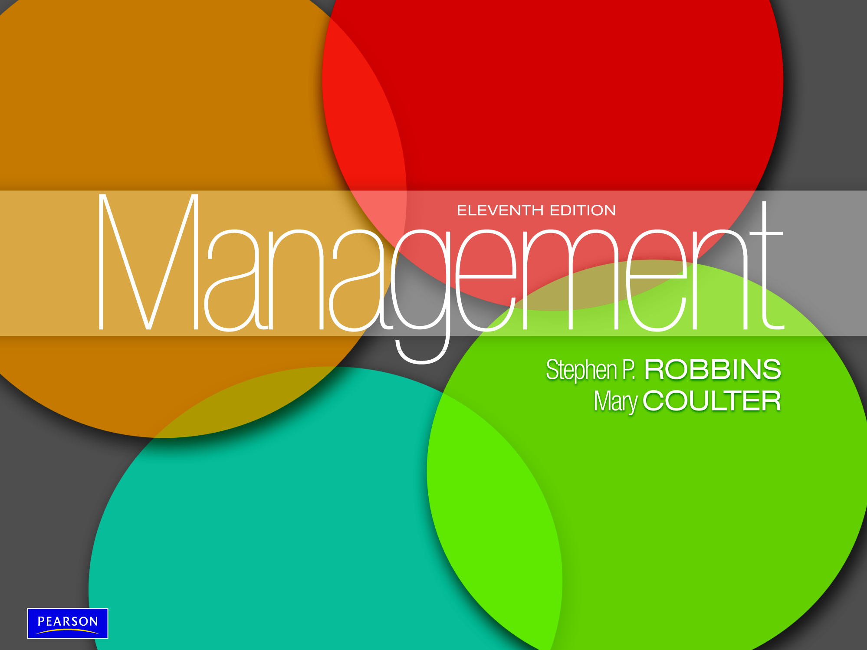

Slide 2
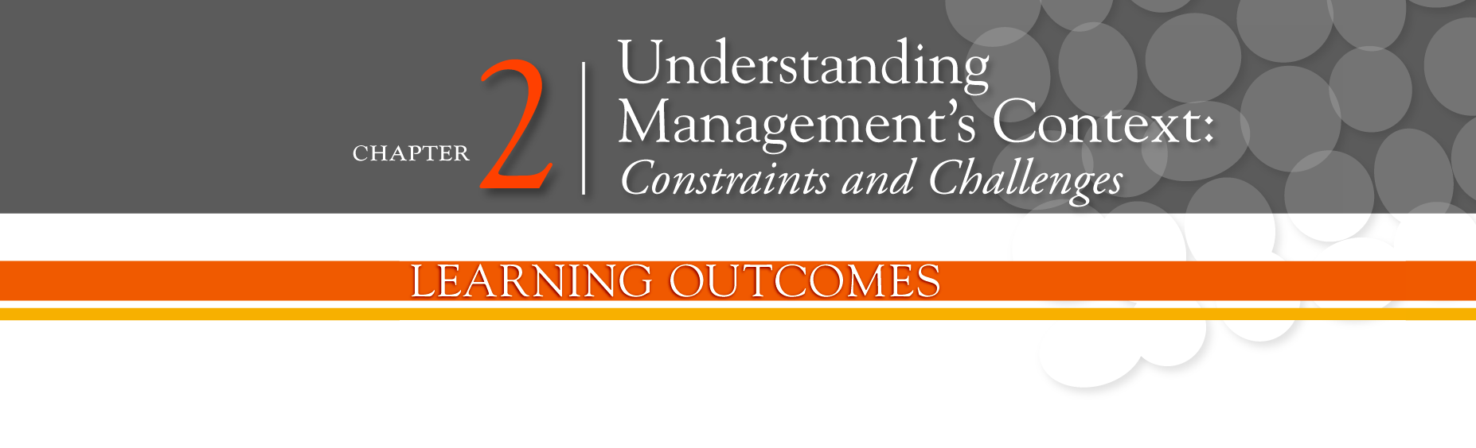
Contrast the actions of managers according to the omnipotent and symbolic views
Describe the constraints and challenges facing managers in today’s external environment
Discuss the characteristics and importance of organizational culture
Describe current issues in organizational culture

Slide 3
阿里巴巴里面独特的面试官：闻味官
闻味官是阿里巴巴自己的创新设计，用来考察求职者的价值观并且选择出跟阿里巴巴价值观相匹配的新员工。虽然阿里巴巴需要那些有能力胜任各种工作的人才，但是在选择测试中能力也只是一种必要但不是决定的因素。
在2009年的时候，在阿里成立10周年之际，在全国展开了一次大规模招聘，这次招聘的不同之处就在于闻味官的涉入并且在面试过程当中权力巨大。闻味官一般由在阿里巴巴工作超过五年并且深知深信阿里巴巴价值观的资深员工担任，由他们负责通过仔细地观察应聘者的言行来判断应聘者的价值观，并且根据他们的经验来选择出那些价值观跟阿里巴巴最相符的应聘者。
除此以外，阿里巴巴还是一个鼓励合作的公司，并且是一个把组织目标看得比个人利益更加重要的公司，所以，闻味官可能会更加注重探求求职者的自我感觉。例如，很多求职者都会因为太以自我为中心而不能被选中;有些求职者声称他们很热爱阿里巴巴，但却没法具体说出热爱哪一方面，这些人则会因为他们的不诚信，跟阿里巴巴的核心价值观相违背，从而被淘汰掉。
总的来说，无法求职者是否有很强的能力，在招聘过程中闻味官都拥有一票否决权，闻味官的面试已经成为了阿里巴巴价值观考核的重要方面。

Slide 4
The Manager:
Omnipotent or Symbolic?
Omnipotent View of Management - the view that managers are directly responsible for an organization’s success or failure.
Symbolic view of Management - the view that much of an organization’s success or failure is due to external forces outside managers’ control.

Slide 5

Exhibit 2-1: Constraints on Managerial Discretion

Slide 6
The External Environment:
Constraints and Challenges
External Environment - those factors and forces outside the organization that affect its performance.
Components of the External Environment
  Specific environment: External forces that have a direct and immediate impact on the organization
  General environment: Broad economic, socio-cultural, political/legal, demographic, technological, and global conditions that may affect the organization

Slide 7
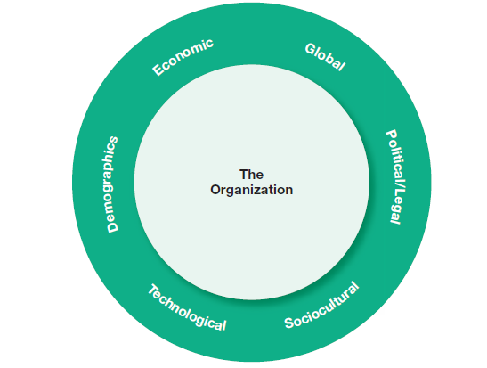
Exhibit 2-2: Components of External Environment

Slide 8
Environmental Uncertainty and Complexity
Environmental Uncertainty - the degree of change and complexity in an organization’s environment.
Environmental Complexity - the number of components in an organization’s environment and the extent of the organization’s knowledge about those components.

Slide 9
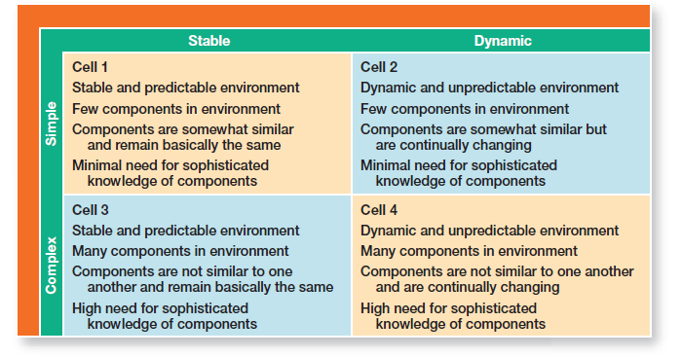
Exhibit 2-3: Environmental Uncertainty Matrix

Slide 10
Who Are Stakeholders?
Stakeholders - any constituencies in the organization’s environment that are affected by an organization’s decisions and actions.

Slide 11
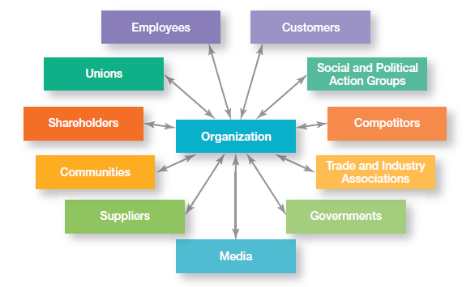
Exhibit 2-4: Organizational Stakeholders

Slide 12
Managing Stakeholder Relationships
Identify the organization’s external stakeholders.
Determine the particular interests and concerns of external stakeholders.
Decide how critical each external stakeholder is to the organization.
Determine how to manage each individual external stakeholder relationship.

Slide 13
What Is Organizational Culture?
Organizational Culture - The shared values, principles, traditions, and ways of doing things that influence the way organizational members act.
Strong Cultures - Organizational cultures in which key values are intensely held and widely shared.

Slide 14
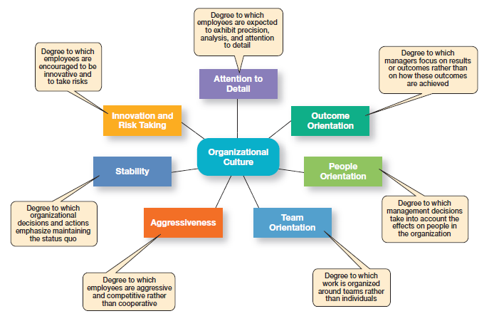
Exhibit 2-5: Dimensions of Organizational Culture

Slide 15
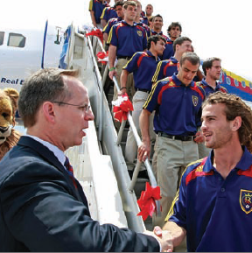
Where Does Culture Come From?
Organization founder
Vision and mission
Past practices
Top management behavior
Socialization - The process that helps employees adapt to the organization’s culture.

Slide 16
How Do Employees Learn Culture?
Stories - Narratives of significant events or people, e.g. organization founders, rule breaking, reaction to past mistakes etc.
Rituals - Sequences of activities that express and reinforce the important values and goals of the organization

Slide 17
How Employees Learn Culture (cont.)
Material Artifacts and Symbols - Convey the kinds of behavior that are expected, e.g. risk taking, participation, authority, etc.
Language - Acts as a common denominator that bonds members

Slide 18
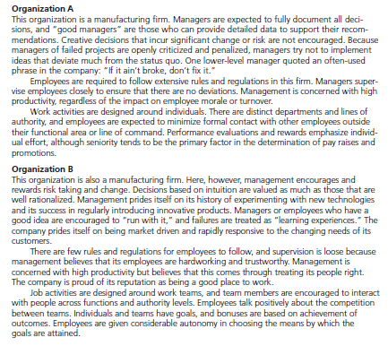
Exhibit 2-6: Contrasting Organizational Cultures

Slide 19
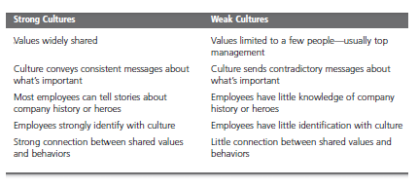
Exhibit 2-7: Strong vs. Weak Cultures

Slide 20
Benefits of a Strong Culture
Creates a stronger employee commitment to the organization
Aids in the recruitment and socialization of new employees
Fosters higher organizational performance by instilling and promoting employee initiative

Slide 21
Organisational Culture
“a pattern of basic assumptions – invented, discovered or developed by a given group as it learns to cope with its problems of external adaptation and internal integration – that has worked well enough to be considered valid, and, therefore, to be taught to new members as the correct way to perceive, think, and feel in relation to those problems.” (Schein, 1985)

Slide 22
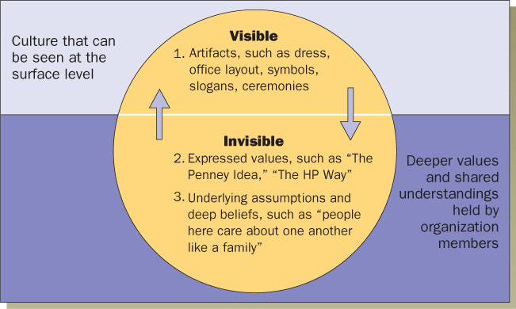
culture

Slide 23
Layers of Organisational Culture
  Artefacts and Products
      Explicit
      Visible Organisational
    structures and processes
  Espoused Norms and Values
      Visions, Missions,
    Business Plans
  Basic Assumptions
      Implicit
      Taken-for-granted beliefs

Slide 24
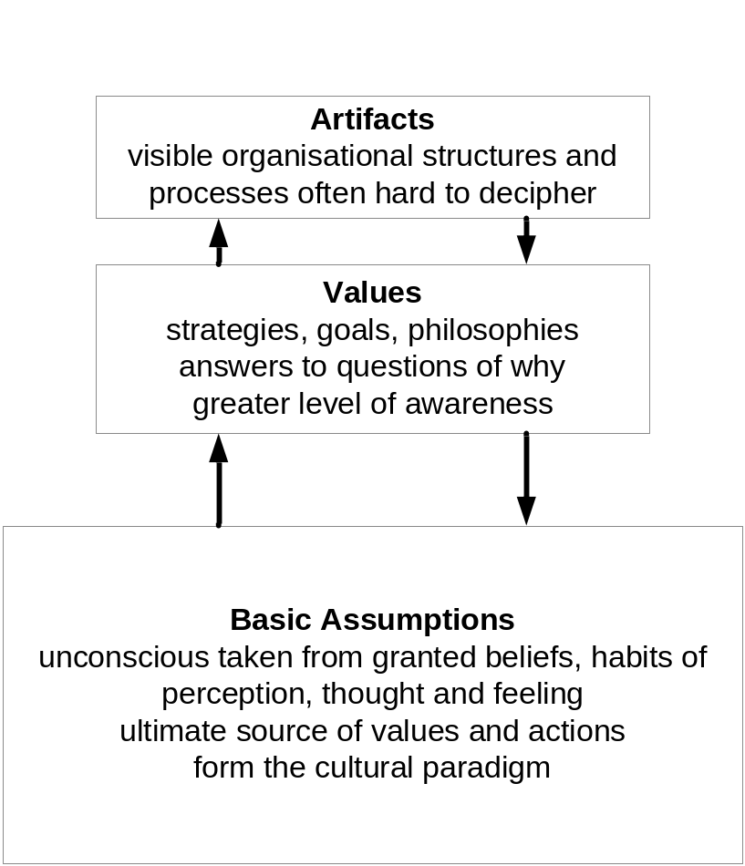

Slide 25
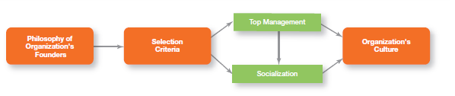
Exhibit 2-8: Establishing and Maintaining Culture

Slide 26
How Does Culture Affect Managers?
Cultural Constraints on Managers
  Whatever managerial actions the organization recognizes as proper or improper on its behalf
  Whatever organizational activities the organization values and encourages
  The overall strength or weakness of the organizational culture

Slide 27
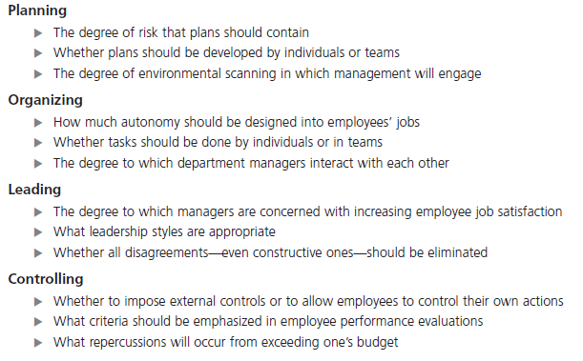
Exhibit 2-9: Managerial Decisions
Affected by Culture

Slide 28
How Do You Create a Customer
Responsive Culture?
Hire the right type of employees (those with a strong interest in serving customers)
Have few rigid rules, procedures, and regulations
Use widespread empowerment of employees
Have good listening skills in relating to customers’ messages

Slide 29
How Do You Create a Customer Responsive Culture?
Provide role clarity to employees in order to reduce ambiguity and conflict and to increase job satisfaction
Have conscientious, caring employees willing to take initiative

Slide 30
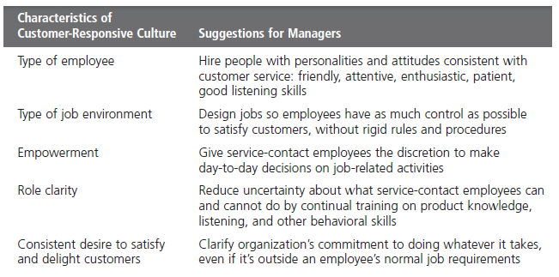
Exhibit 2-10: Creating a Customer
Responsive Culture

Slide 31
Spirituality and Culture
Workplace Spirituality - a culture where organizational values promote a sense of purpose through meaningful work that takes place in the context of community
Characteristics of a Spiritual Organization
  Strong sense of purpose
  Focus on individual development
  Trust and openness
  Employee empowerment
  Toleration of employees’ expression

Slide 32
Terms to Know
omnipotent view of management
symbolic view of management
organizational culture
strong cultures
socialization
workplace spirituality
external environment
specific environment
general environment
environmental uncertainty
environmental complexity
stakeholders

Slide 33
